Slide 1
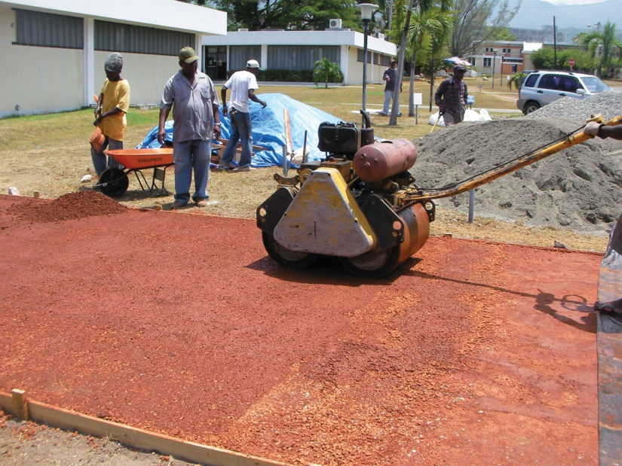
FIGURE 41.1 Roller Compacted Zero Cement Concrete in Jamaica
Copyright © 2016 Elsevier Ltd. All rights reserved.

Slide 2
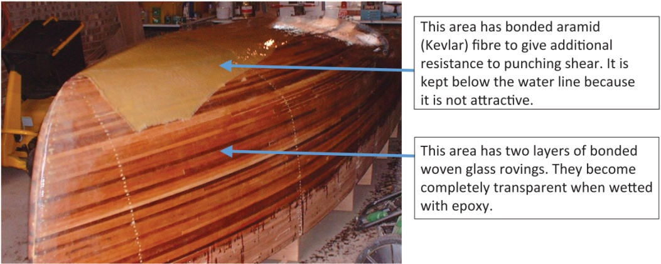
FIGURE 41.2 Wood–Glass–Epoxy Composite Construction of a Boat
Copyright © 2016 Elsevier Ltd. All rights reserved.

